Slide 1



QC – PILLAR
Quality Control
Callao | Melisa Medina
Marzo 2023

Slide 2
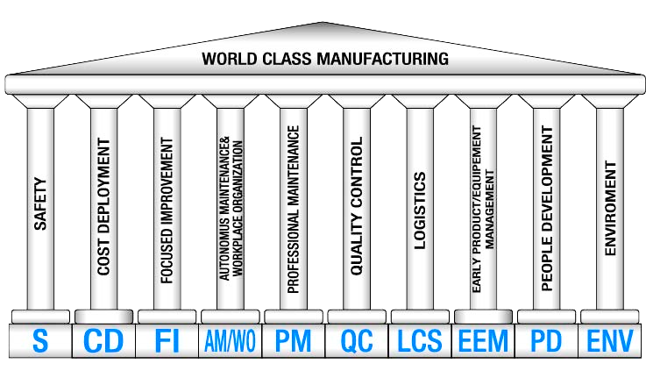
World Class Services Pillars
World Class Manufacturing consta de 10 Pilares Gerenciales y 10 Pilares Técnicos.
Notes:
Heavier content slide.

Slide 3
Contents
1. Introduction
1.1 Vision, Needs, Objectives and Target
1.2 KPI & KAI
1.3 Route map
1.4 Pillar Team y carta radar
1.5 Governance & meeting system
2. Implementation Methodology
2.1 Reactive Non-Conformity Management System
Introduction
QA Matrix
2.2 Development of Kaizens (Method / Man)
Introduction
Resolution
Man
Method
2.2 Development of Kaizen (Machine)
Introduction
Resolution
Machine
3. KPI & KAI Archieved Results
4. SWOT
5. Next Steps
Notes:
Heavier content slide.

Slide 4

Introduction
1.1 Vision, Needs, Objectives and Target
1.2 KPI & KAI
1.3 Route map
1.4 Pillar Team
1.5 Governance & meeting system
© SGS Group Management SA – 2020 – All Rights Reserved – SGS is a registered trademark of SGS Group Management SA
Notes:
This´s the Content, similar to others pillars
A

Slide 5



1.1 VNOT
OBJECTIVES
Reduce customer complaints.
Improve the quality standards of our services to reduce the repetition of tests.
Strengthen staff skills to identify and resolve quality issues.
VISION
Total customer satisfaction through the delivery of excellent quality services.
NEEDS
Strengthen the culture of continuous improvement through the WCS.
Implement the non-conformity identification system.
Increase the registration of real defects.
Improve existing conditions and controls.
Attack nonconformities in such a way that robust controls are applied so that they do not happen again.
VNOT
TARGETS
Reduce claims <0.03 %
Reduce retests < 0.78 %
Notes:
Heavier content slide.

Slide 6
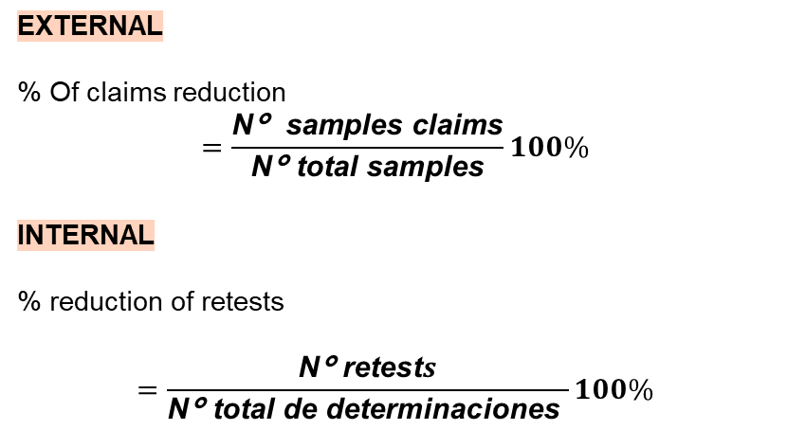
1.2 KPI’S & KAI’S
Key Performance Indicators
(Key Performance Indicators)
Key Activity Indicators
(Key Activity Indicators)
N° Kaizen
Closing of claims
N° Trainings
N° people involved
ExternAL
% Of claims reduction
$$=\frac{\text{N}\text{°} \text{samples} \text{claims}}{\text{N}\text{°} \text{total} \text{samples}}100\%$$
INTERNAL
% reduction of retests
$$=\frac{\text{N}\text{°} \text{retest}s}{\text{N}\text{°} \text{total} \text{de} \text{determinaciones} }100\%$$
Notes:
Heavier content slide.

Slide 7
1.3 ROUTE MAP
Year
2022
2023 - 1
2023 - 2
2024
2025
Pillar Score
Kick Off
1
2
3-4
4-5
METHODOLOGY AND TOOLS
10 QC views
7 Basic Quality Control Tools
Fault knowledge and record
Development of the QA matrix
Priority index
Knowledge of PDCA
7 QA troubleshooting steps to determine the root cause.
7 Basic Quality Control Tools
WCS-QC Tools
5G/5W+1H, 5Why
TWTTP/HERCA
Kaizen logic and PDCA
7 steps of QM (Steps1-4)
Analysis and countermeasures (man, machine, material and method)
5QF0D
QM Matrix
SQC for product characteristics
Quality Gate
8 Stages of Incoming materials – reactive
Reactive QA Network
Mistake or Error Proof
Visual Aids/ Alarm/ Visual SOP
7 steps of QM (Steps1-6)
X Matrix / QM Matrix
DOE ( Design of Experiment)
8 Stages of Incoming Material
Preventive QA Network
Preventive QA matrix
Preventive HERCA
New 7 QC tools
PPA ( Process Point Analysis)
O&R (Occurence & Release Analysis)
QFD ( Quality Function Deployment)
7 steps of Quality Maintenance (with Focus on Step 3-7)
DOE ( Design of Experiment)
PFMEA (Process Failure Mode & Effects Analysis)
FTA ( Fault Tree Analysis)
Taguchi Method
ANOVA
Proactive QA matrix
KPI
% Of claims reduction
%reduction of retests
2019
1. <0.03%
2. <0.78%
1. 10% less than the previous year
2. 10% less than the previous year
1. 10% less than the previous year
2. 10% less than the previous year
1. 10% less than the previous year
2. 10% less than the previous year
1. 10% less than the previous year
2. 10% less than the previous year
KAI
N° Kaizen
Close of claims
N° Training
N° people involved
--------
1. 4
2. 2
3. 12 annual
10%
1. -
2. -
3. 12 annual
15%
1. -
2. -
3. > 12 annual
20%
1. -
2. -
3. > 18 annual
> 20%
7

Slide 8
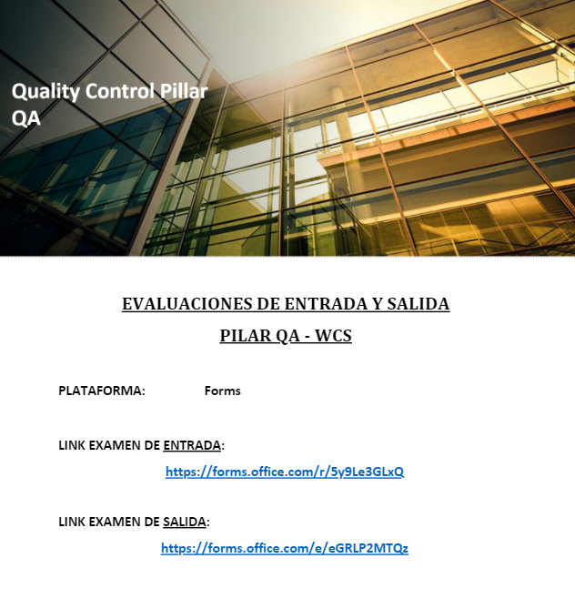
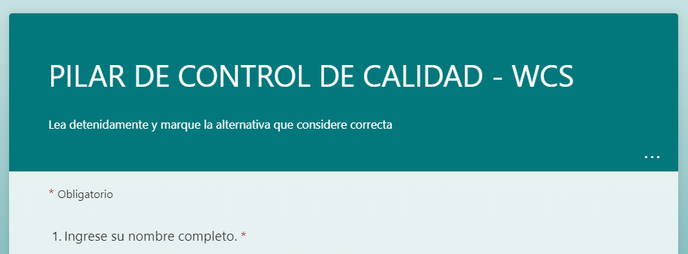
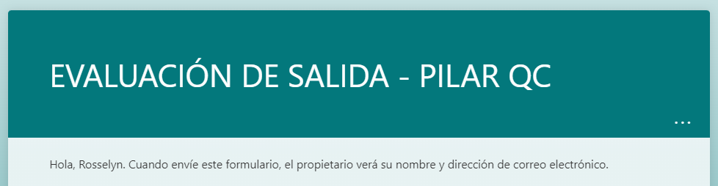
1.4 PILLAR TEAM
ACCESS TO THE QC PILLAR TEST IN/OUT
Notes:
Heavier content slide.

Slide 9



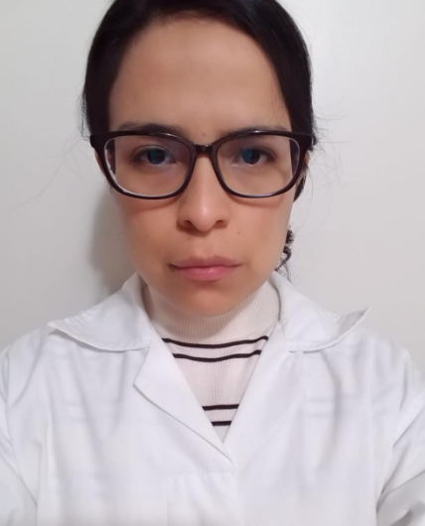
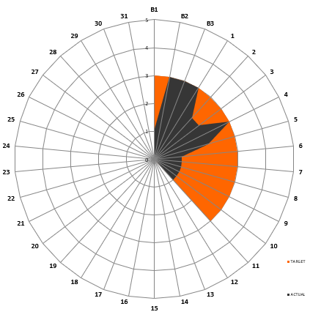
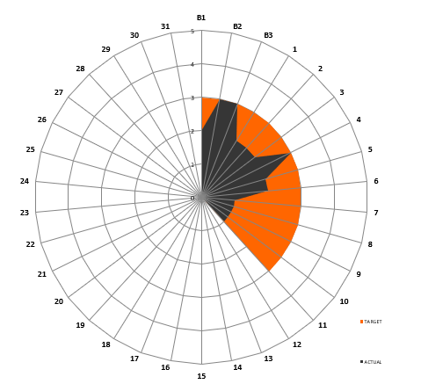
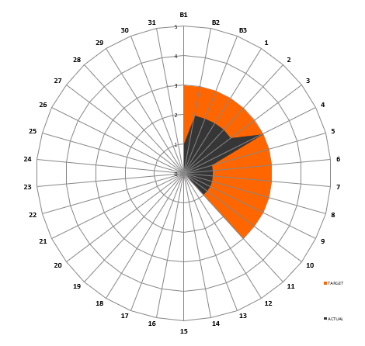
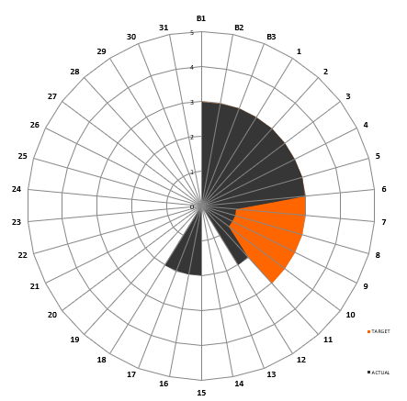
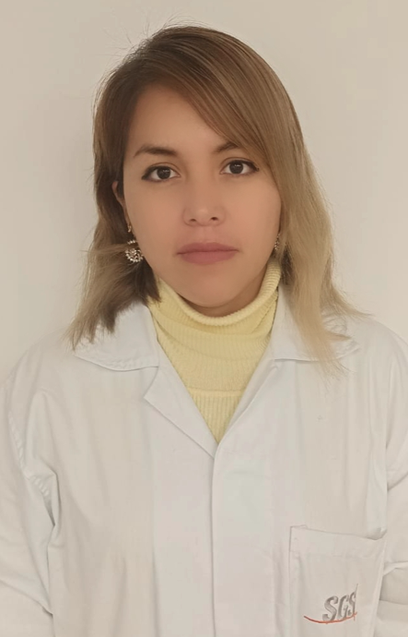
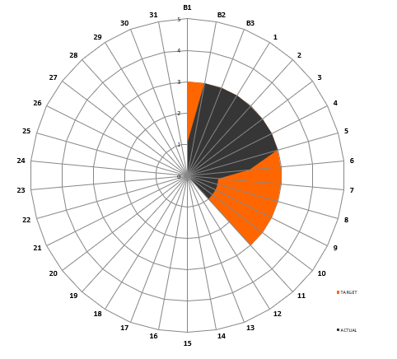

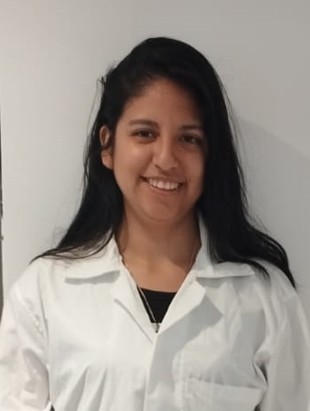
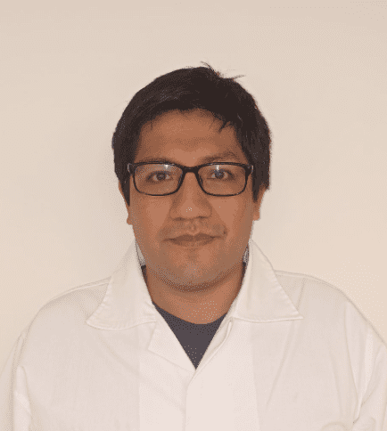
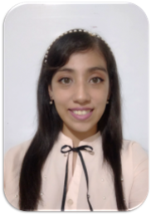
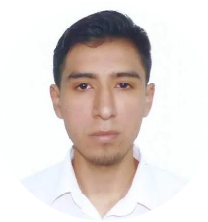
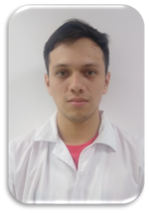
1.4 PILLAR TEAM
C
O
R
E
T
E
A
M
Cesar Mendoza
Analista Aires
Janeth Contreras
Analista GCMS
Stefany Soto
Analista Instrumental I
Melisa Medina
Analista Instrumental III
QC Pillar Leader
Rosselyn Colca
Analista Senior
María Yauri
Analista Instrumental II
QC Pillar Co - Leader
Alessandra Guerrero
Analista GCMS
EXTENDED TEAM
Junior Ñiquen
CD Pillar Leader
Estefany Braul
PD Pillar Leader
Leonardo Castillo
FI Pillar Leader
Juan Vasquez
AM Pillar Leader
Notes:
Heavier content slide.

Slide 10

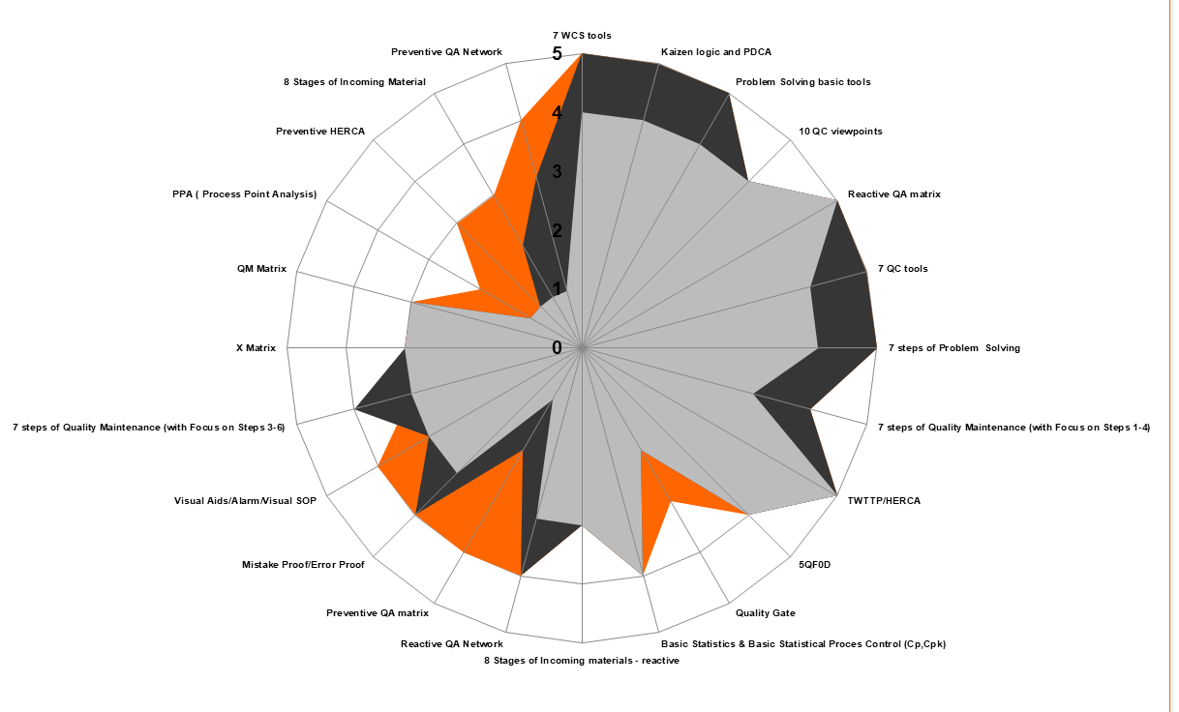
1.4 Carta Radar
Pilar Team Max Score
Update: May 2022
Tools apply in 2022 - 2023
REACTIVE
BASIC KNOWLEDGE – REACTIVE
Reactive QA matrix
7 QC tools
7 steps of Problem Solving
7 steps of Quality Maintenance (with Focus on Steps 1-4)
TWTTP/HERCA
5QF0D
Basic Statistics & Basic Statistical Proces Control (Cp,Cpk)
Quality Gate
Reactive QA Network
Kaizen logic and PDCA
Problem Solving basic tolos
10 QC viewpoints
7 WCS tools
8 Stages of Incoming materials - reactive
Target
Actual Status
Initial Status
Level | Definition
1 | No Knowledge
2 | Knowledge
3 | Under guide
4 | Work Independent
5 | Training people
Notes:
Se muestra las competencias requeridas para este año 2022.

Slide 11
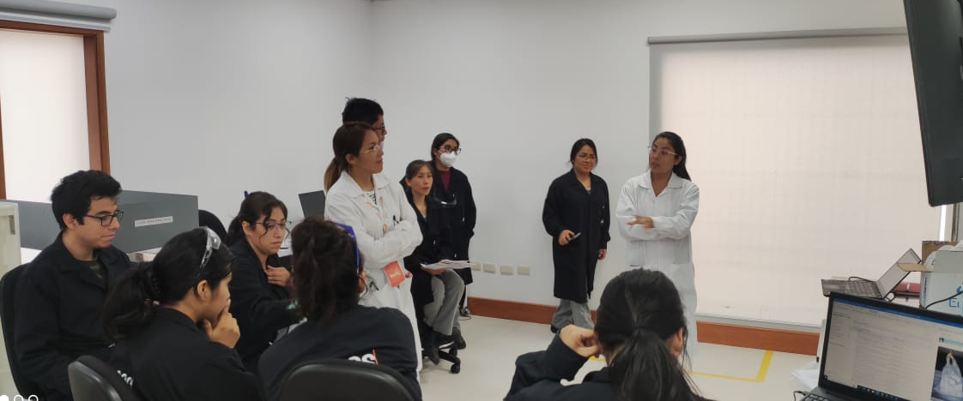
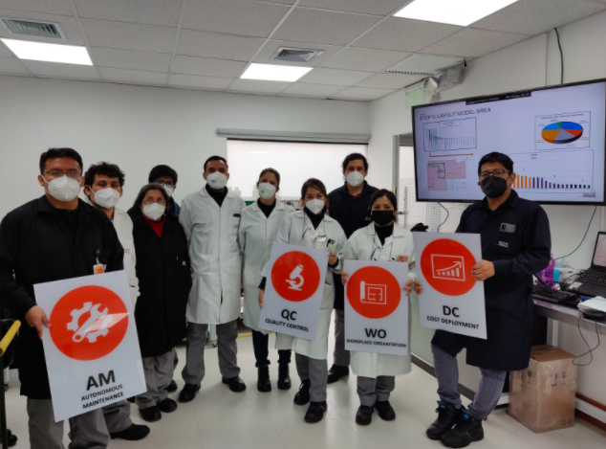
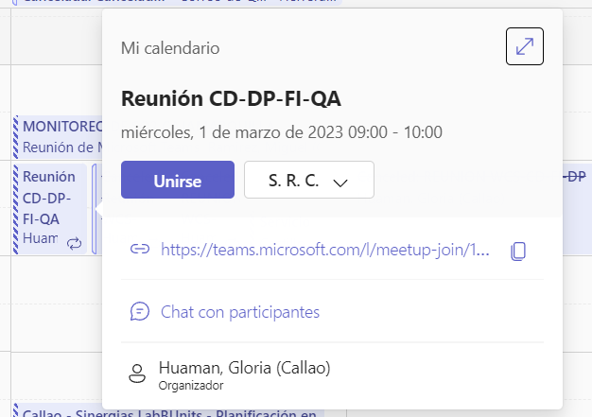
1.5 GOVERNANCE & MEETING SYSTEM
Regarding training, organization, planning and monitoring of activities, the following meetings are held:
Pillar Members
Pillar Leaders and area managers
Triangle & QC Meeting
Monitoring and review of progress of each pillar.​
Monitoring of the quality managemenet system
3. Weekly on Tuesday.
Feasibility of pillar projects and the suggestion box.
Dissemination of information.
3. Weekly on Thursday.
Monitoring and review of projects.​
Dissemination of information.
3. Weekly on Thursday.

Slide 12
2. Implementation Methodology
2.1 Reactive Non-Conformity Management System
Introduction
QA Matrix
2.2 Development of Kaizens (Method / Man)
Introduction
Resolution
Man
Method
2.2 Development of Kaizen (Machine)
Introduction
Resolution
Machine
© SGS Group Management SA – 2020 – All Rights Reserved – SGS is a registered trademark of SGS Group Management SA
Notes:
This´s the Content, similar to others pillars
A

Slide 13
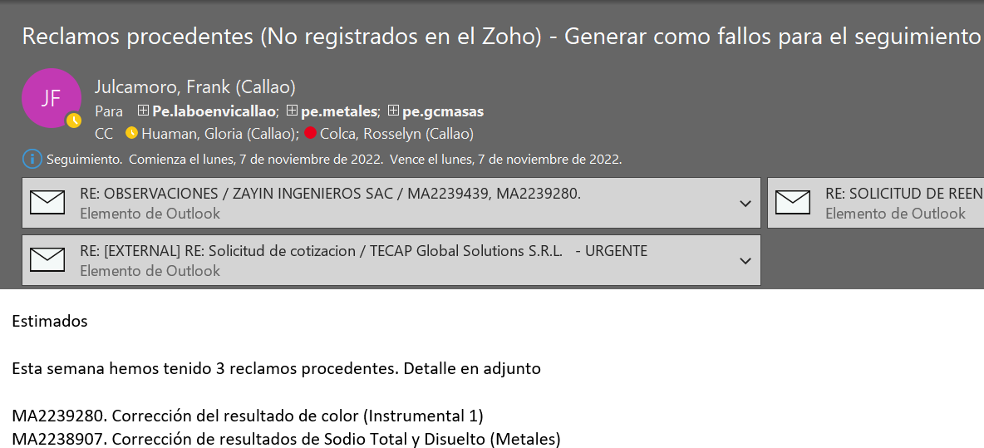
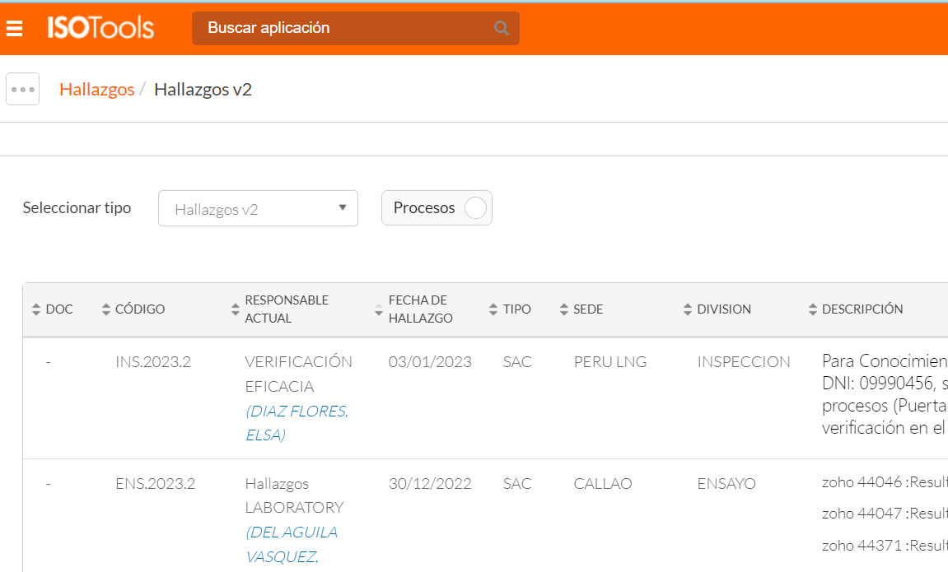


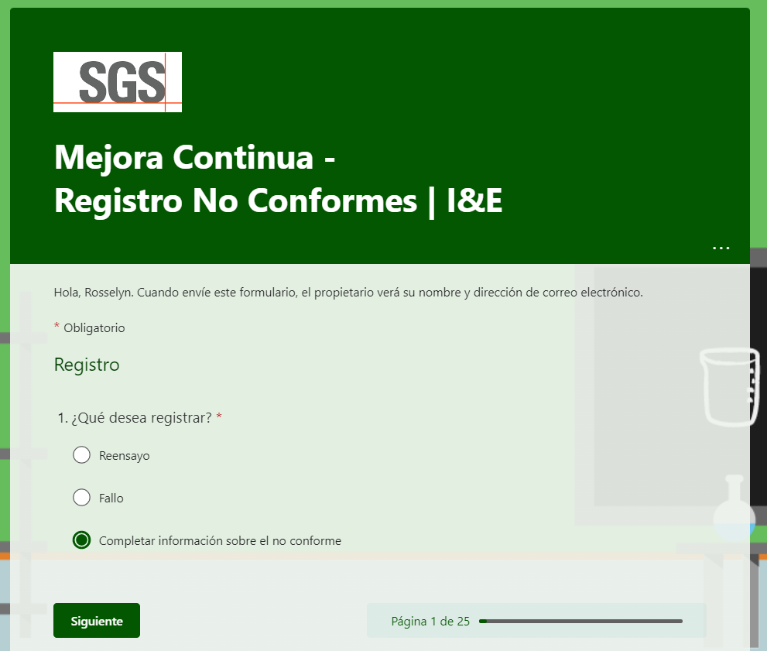
2.1 Reactive Non-Conformity Management System
Sources for recording failures
Observaciones Reclamos
Hallazgos
(PNC, SAI, SAP, SAC)
Registro de
fallos
Notes:
Heavier content slide.

Slide 14
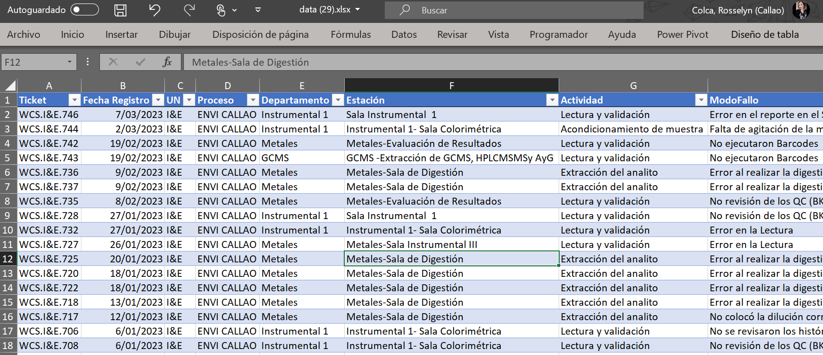
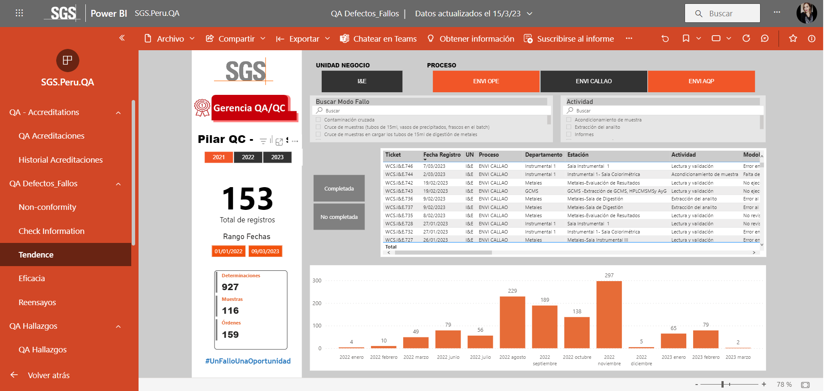
I. INTRODUCTION
II. Data consolidation / monitoring
Register of
failures
Complete the category of the cause and treatment of the failure
III. Data download
Exportable .xls file with FAULTS data
PBI FAULTS
Notes:
Heavier content slide.

Slide 15
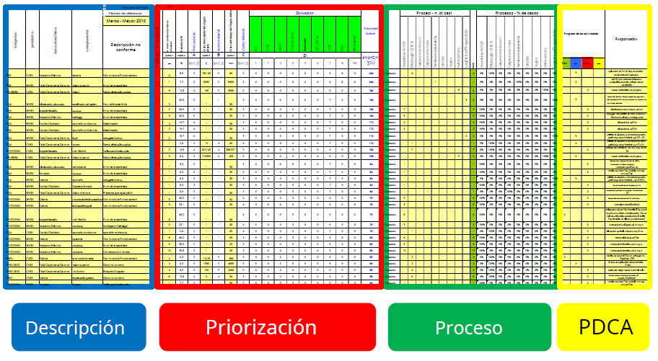
IV. QA MATRIX
The QA MATRIX is divided into 4 sections

Slide 16
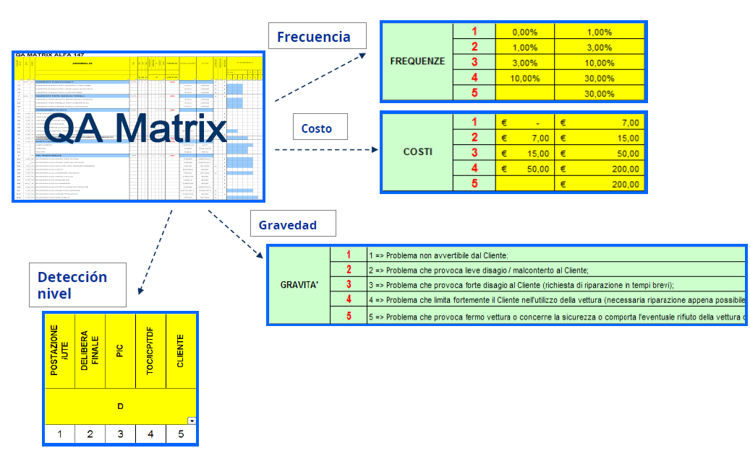
IV. QA MATRIX
PRIORITY INDEX
Priority Index = A(Frecuency) * B(Cost) *C( Severity) * D(∑ Detection( $i$))

Slide 17
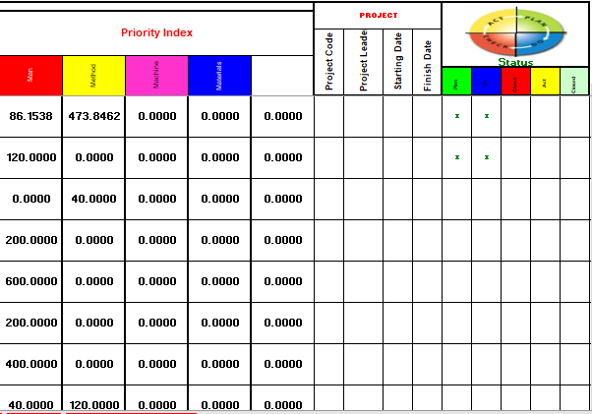
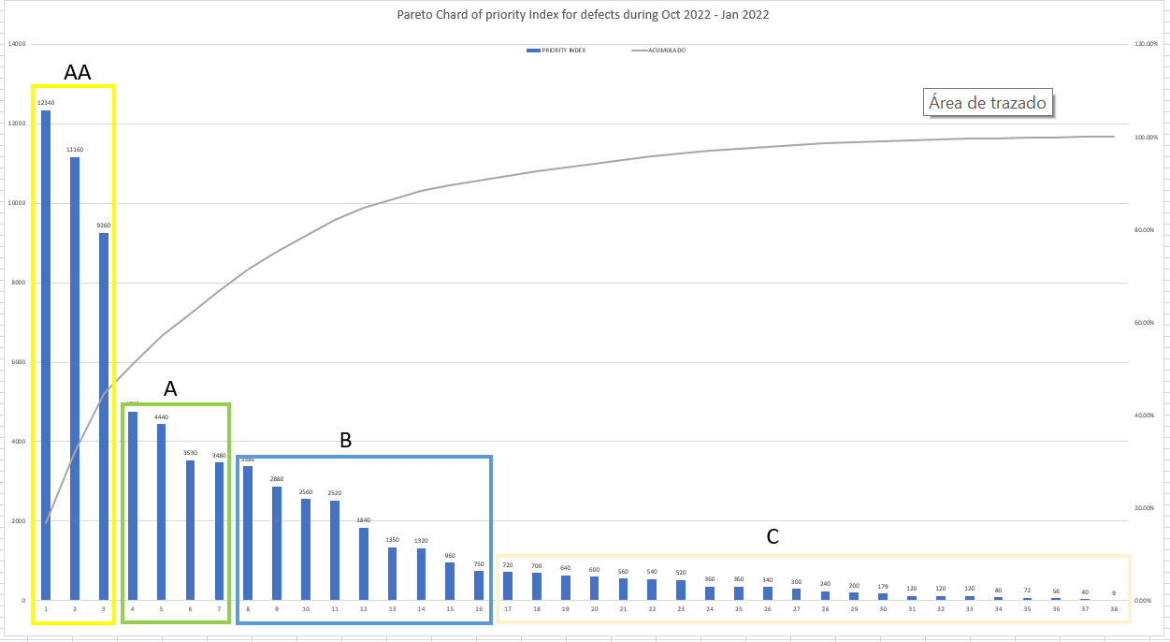
IV. QA MATRIX
QA MATRIX - I&E CALLAO
A B C D
PRIORITY INDEX
PARETO CHART
Priority Index = A(Frequency) * B(Cost)
* C( Severity) * D(∑ Detection(𝒊))

Slide 18
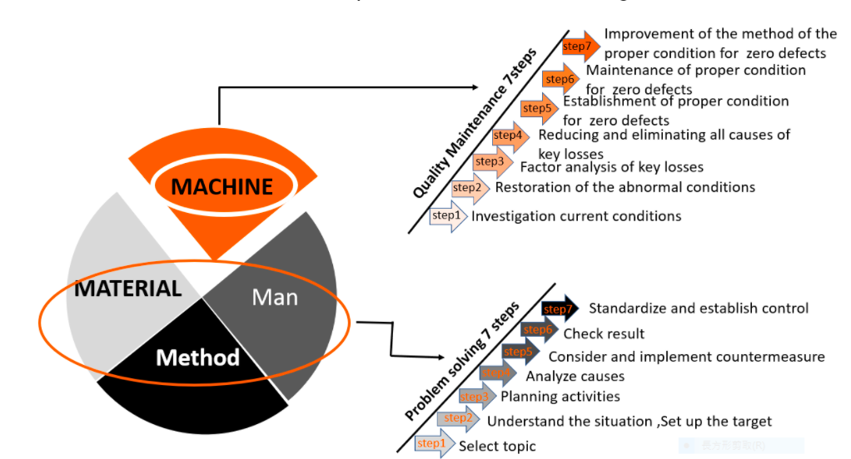
2.2 DEVELOPMENT OF KAIZENS (Man / Method)
INTRODUCTION
According to the category, we must define the correct Methodology.
Quality Maintenance QM
7 steps
Quality Control QC
Problem solving 7 steps
Notes:
Heavier content slide.

Slide 19
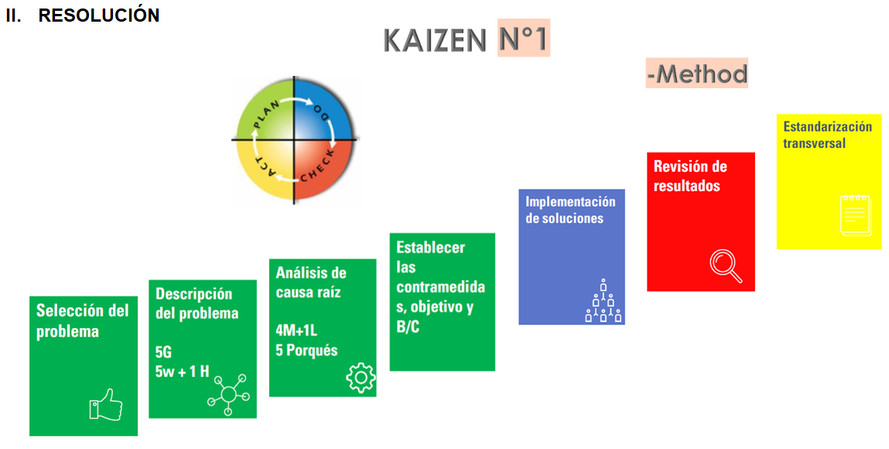


2.2 DESARROLLO DE KAIZENS (Method / Man)
ERROR IN THE REPORT IN THE SLIM
Notes:
Heavier content slide.

Slide 20
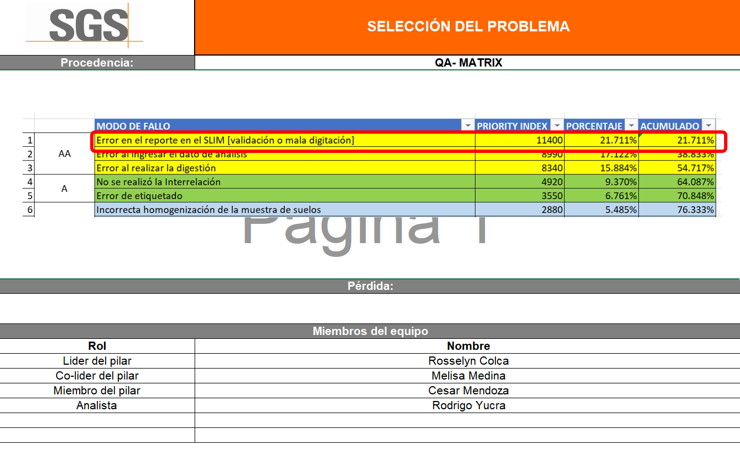
PASO 1:
SELECCIÓN DEL PROBLEMA

Slide 21
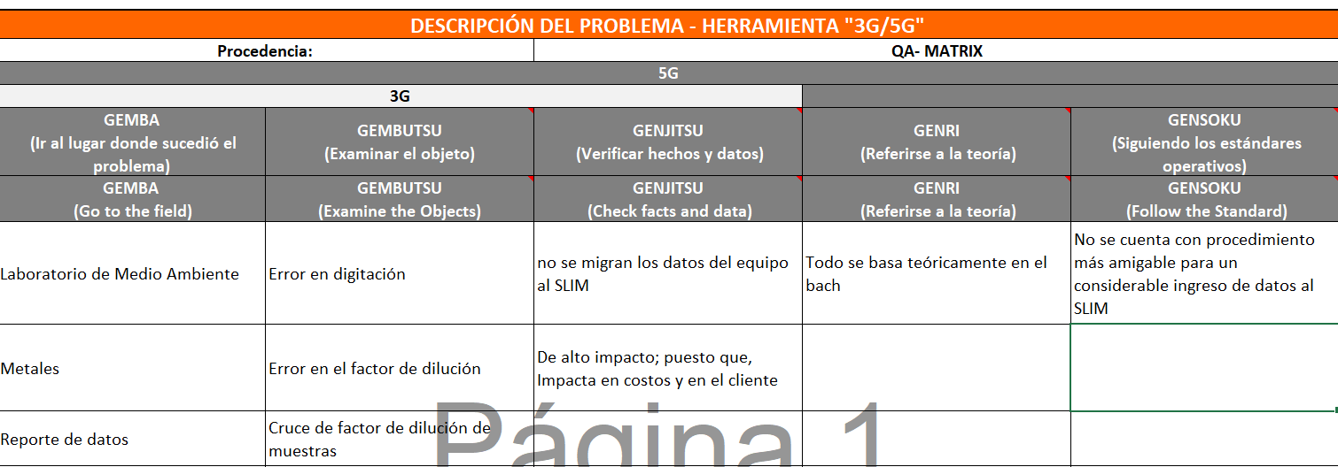
STEP 2:
a) DESCRIPTION OF THE 3G/5G PROBLEM

Slide 22
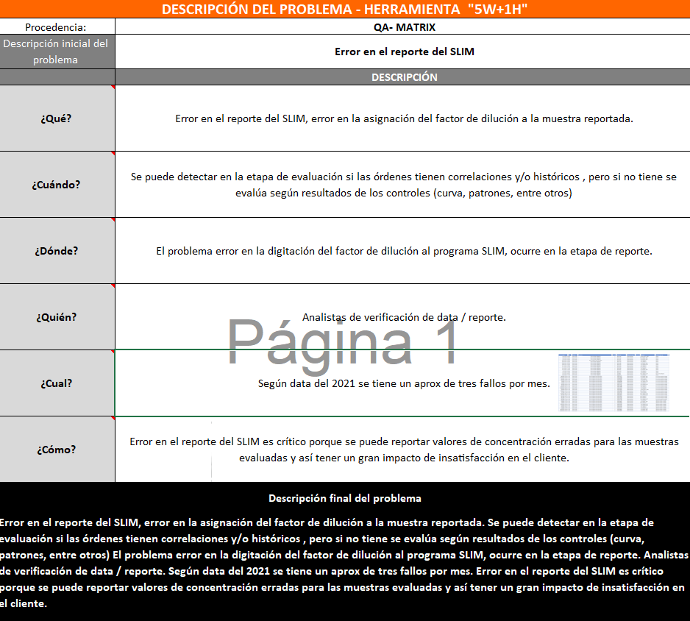
STEP 2:
b) DESCRIPTION OF THE PROBLEM 5W + 1H

Slide 23
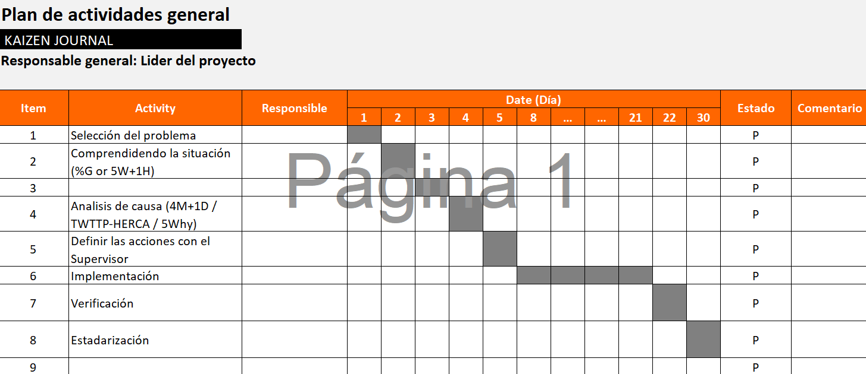
STEP 3:
KAIZEN JOURNAL

Slide 24
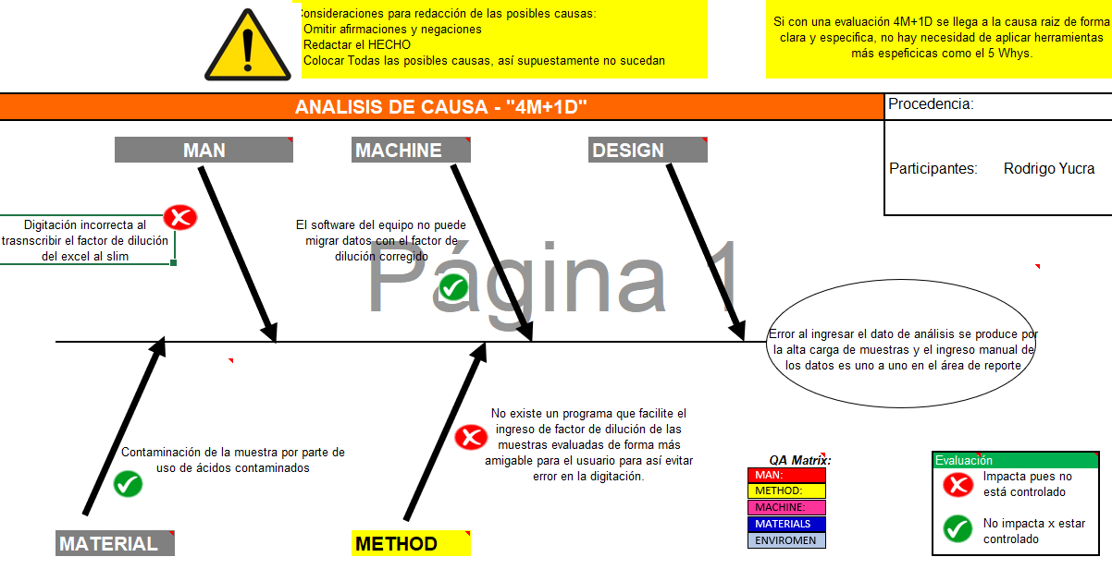
STEP 4:
a) ROOT CAUSE ANALYSIS – 4M

Slide 25
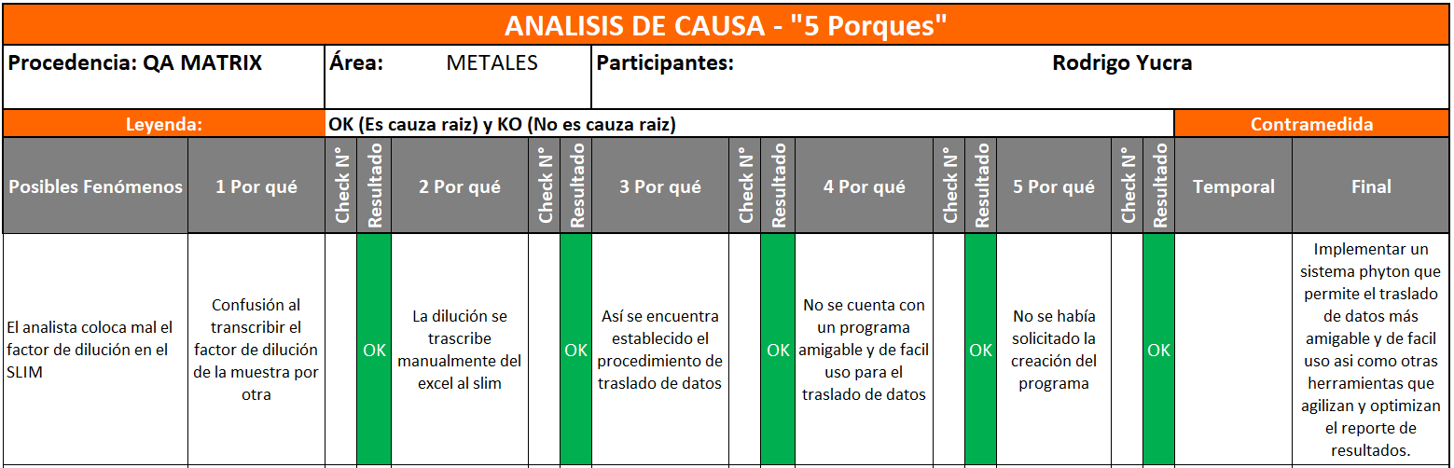
STEP 4:
b) ROOT CAUSE ANALYSIS – 5 WHYS

Slide 26
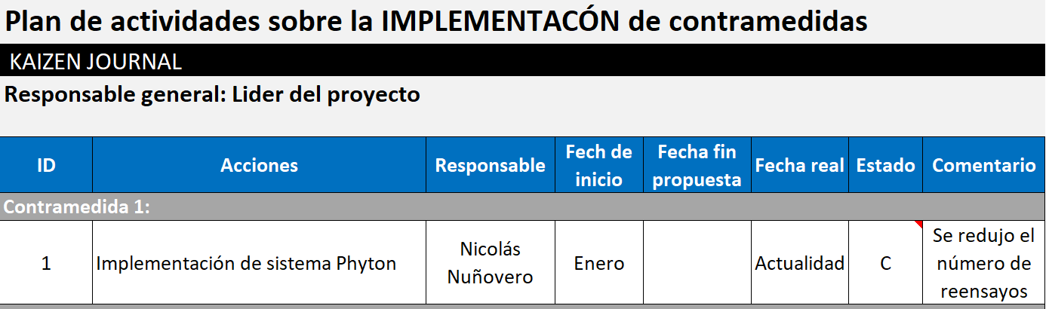
STEP 5:
ESTABLISH COUNTERMEASURES

Slide 27
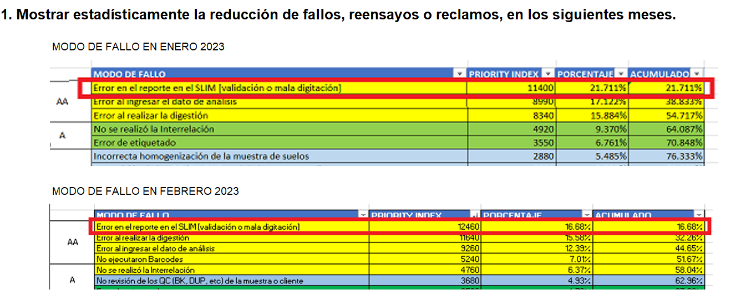
STEP 6:
RESULTS CHECKING

Slide 28
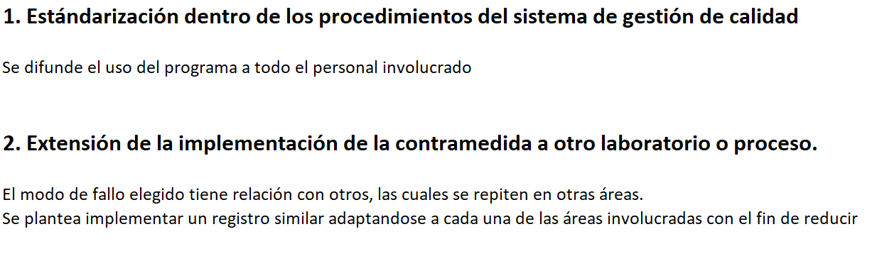
STEP 7:
STANDARDIZATION

Slide 29
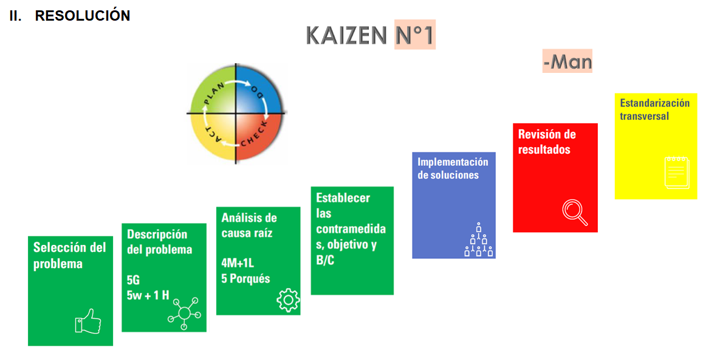

2.2 DEVELOPMENT OF KAIZENS (Method / Man)
ERROR IN TYPING
Notes:
Heavier content slide.

Slide 30
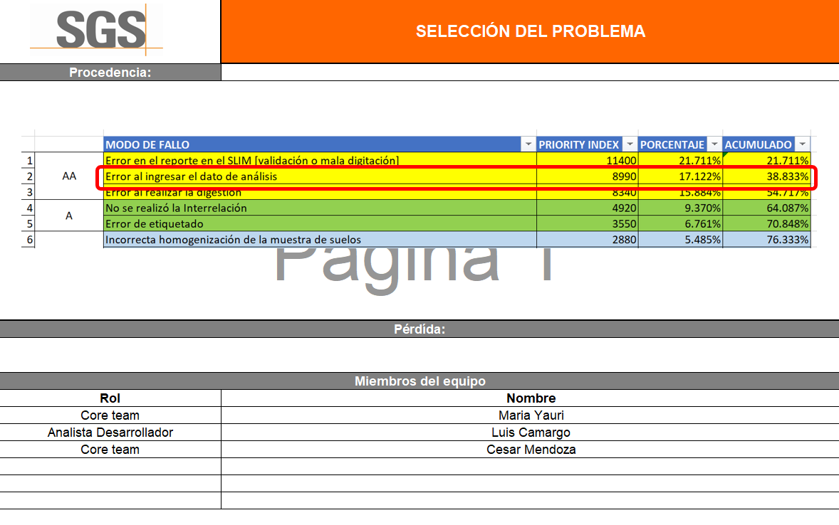
STEP 1:
PROBLEM SELECTION

Slide 31
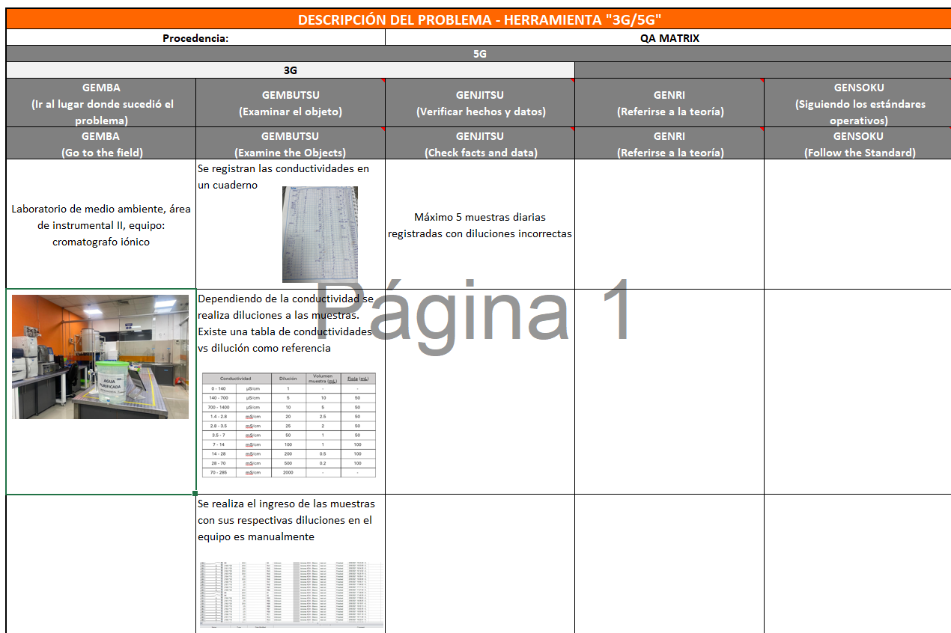
STEP 2:
a) DESCRIPTION OF THE 3G/5G PROBLEM

Slide 32
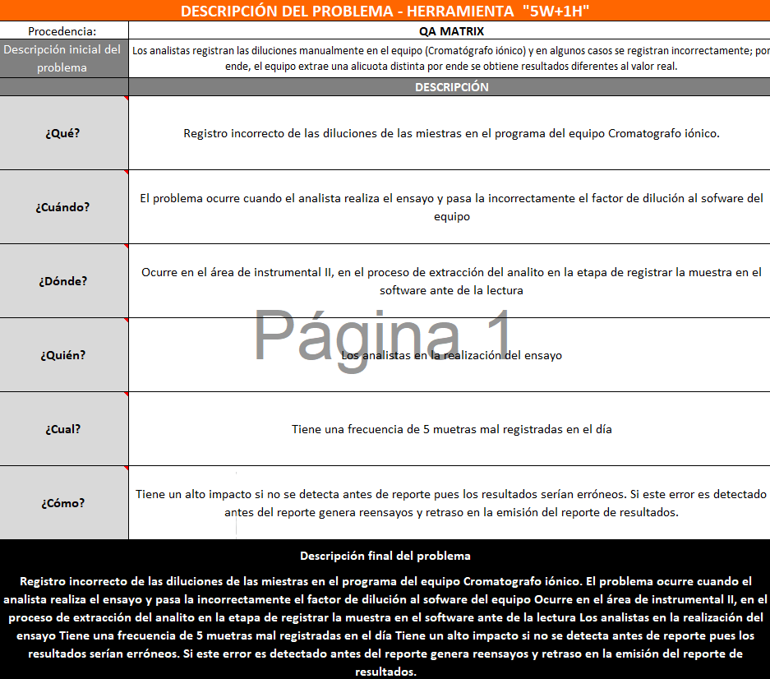
STEP 2:
b) DESCRIPTION OF THE PROBLEM 5W + 1H

Slide 33
STEP 3:
KAIZEN JOURNAL

Slide 34
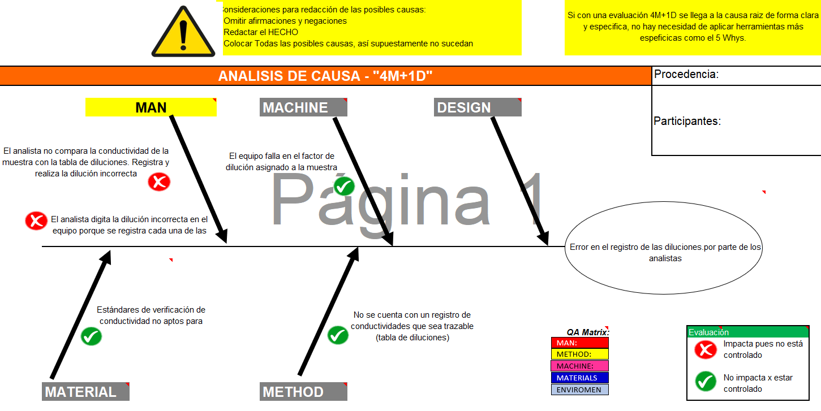
STEP 4:
a) ROOT CAUSE ANALYSIS – 4M

Slide 35
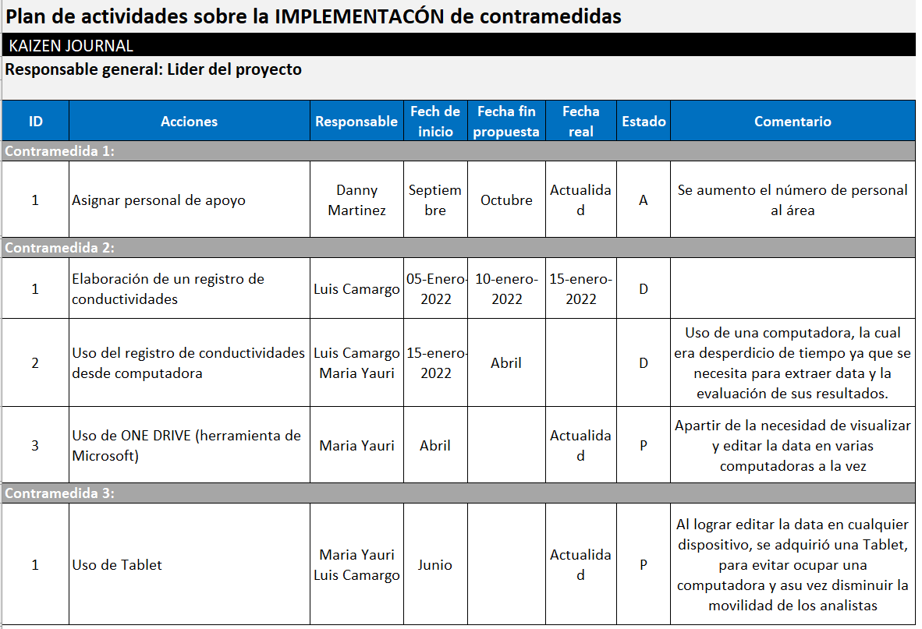
STEP 5:
ESTABLISH COUNTERMEASURES

Slide 36
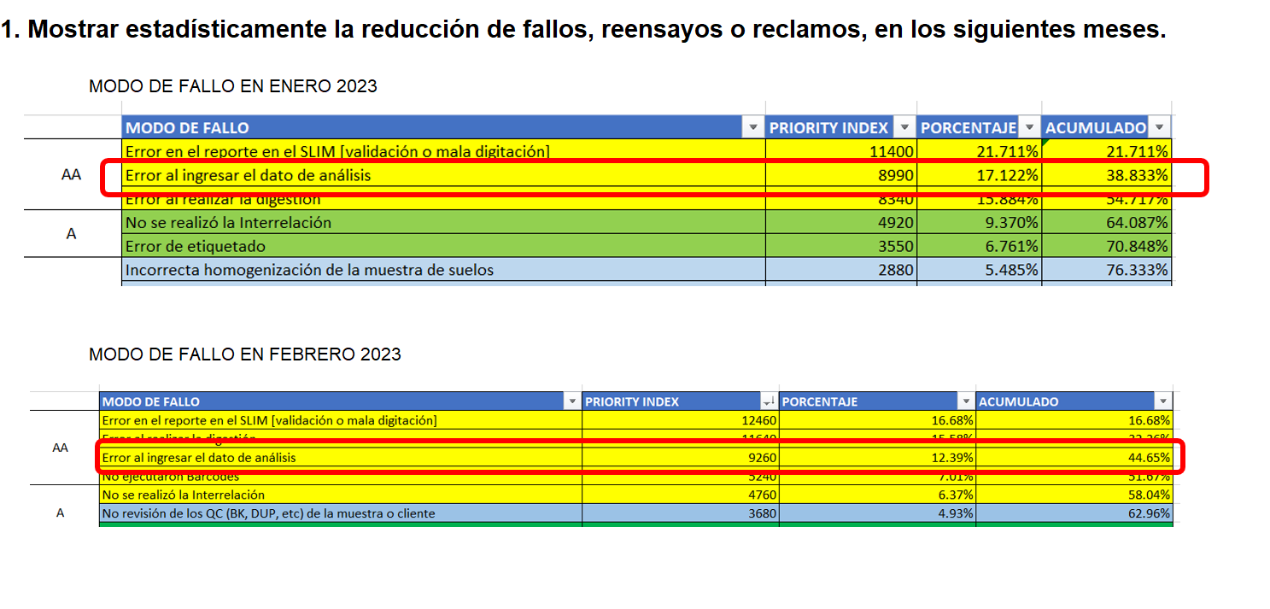
STEP 6:
RESULTS CHECKING

Slide 37
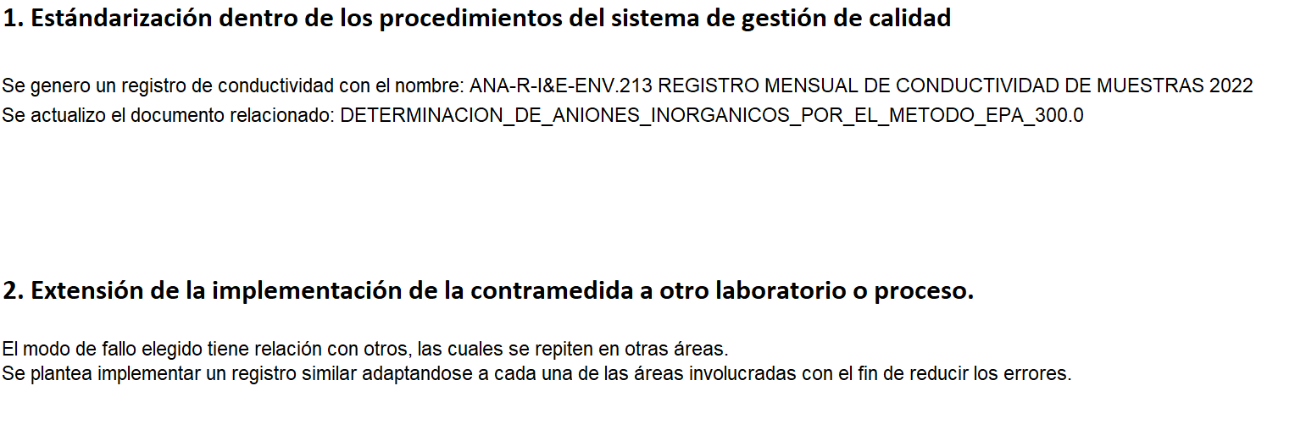
STEP 7:
STANDARDIZATION

Slide 38
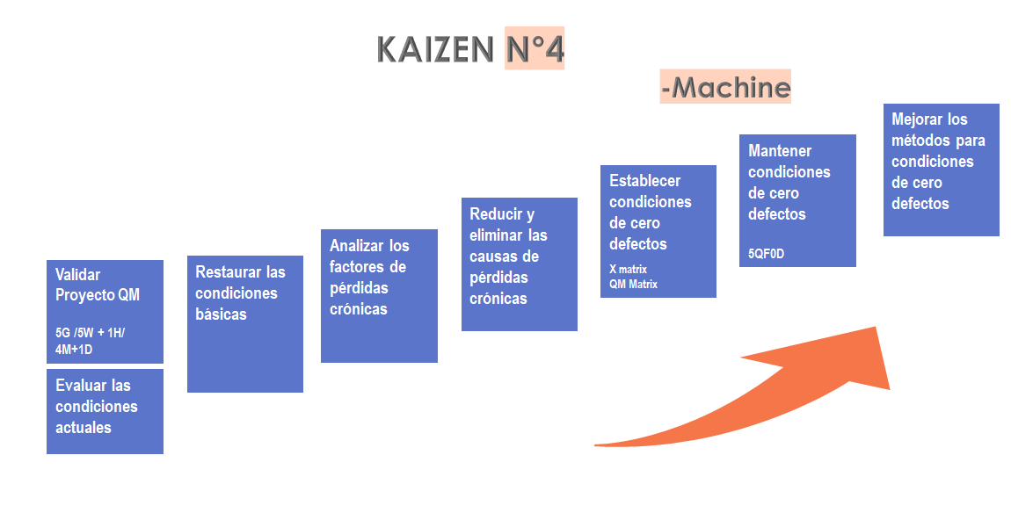
2.3 KAIZEN DEVELOPMENT (Machine)
RESOLUCIÓN
GC-MS PROJECT
Notes:
Heavier content slide.

Slide 39

STEP 1:
b) 3G/5G PROBLEM DESCRIPTION

Slide 40

STEP 1:
c) DESCRIPTION OF THE PROBLEM - 4M
c) DESCRIPCIÓN DEL PROBLEMA 5W + 1H

Slide 41

STEP 1:
d) ASSESS CURRENT CONDITIONS

Slide 42


STEP 2:
RESTORE BASIC CONDITIONS

Slide 43

STEP 5:
ESTABLISH ZERO DEFECT CONDITIONS (X MATRIX)

Slide 44

STEP 5:
MAINTAIN ZERO DEFECT CONDITIONS 5QF0D

Slide 45
3. KPI & KAI Archieved Results
4. SWOT
5. Next Steps
© SGS Group Management SA – 2020 – All Rights Reserved – SGS is a registered trademark of SGS Group Management SA
Notes:
This´s the Content, similar to others pillars
A

Slide 46



3. KPI & KAI ARCHIVIED RESULTS
KPI (Jan – Feb 2023)
KAI (Jan – Feb 2023)
Notes:
Heavier content slide.

Slide 47





4. SWOT
Multidisciplinary teamwork with different skills.
Team commitment and organized.
Think team.
ISO 17025 certification.
We have a culture of continuous improvement.
Few participation of the quality control pillar team
The implemented management system doesn´t have a solid approach preventive focus.
High staff turnover
Extend kaizens to similar activities in other areas
To stand out as a company with a preventive approach
Increase quality control pillar team participation in the WCS
No-quality materials (reactive and tools)
Equipment not available
No assignment of new collaborators to expand their skills for solve quality problems.
COVID-19
Entry of new competitors into the sector.
Notes:
Heavier content slide.

Slide 48

5. NEXT STEPS
For the new projects
Promote the application of Poka Yoke and SOP countermeasures
QC Pilar
Establish the QA Network preventive
QC Pilar
Increase the participation and competence of the team of the quality control pillar.
QA Matrix
Continue close of projects of the QA matrix (Apr-Mar 2023)
Notes:
QM – 7 Steps: Advance the project to step 4.
QA Matrix: Starting the recopiling data for the new QA Matrix 2020-II.
QC Pilar: Increasing the involvement of the people
For the new projects: Promote the application of Poka Yoke, Error Proof and SOP countermeasures
Planes a futuro????

Slide 49

Thank you!
Notes:
Final slide.

Slide 52



1.4 PILLAR TEAM
Pillar meeting
Notes:
Heavier content slide.

